Slide 1
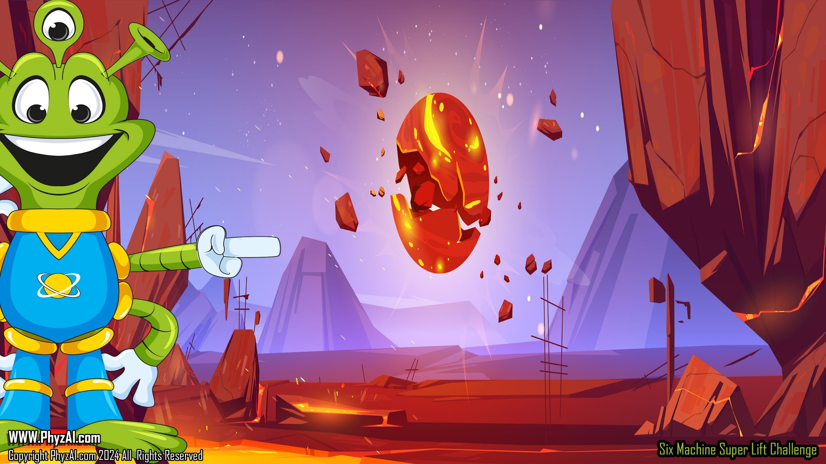
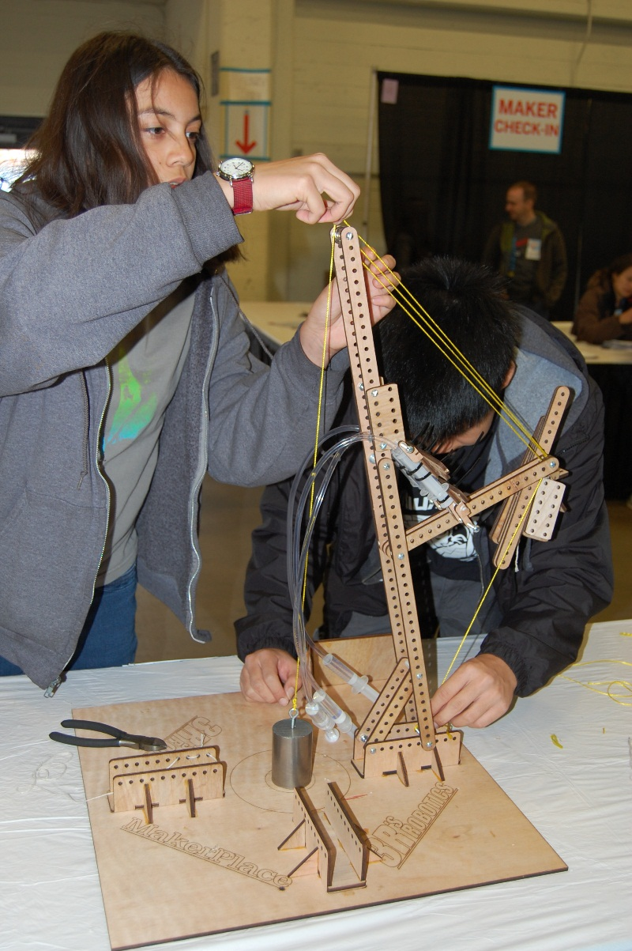
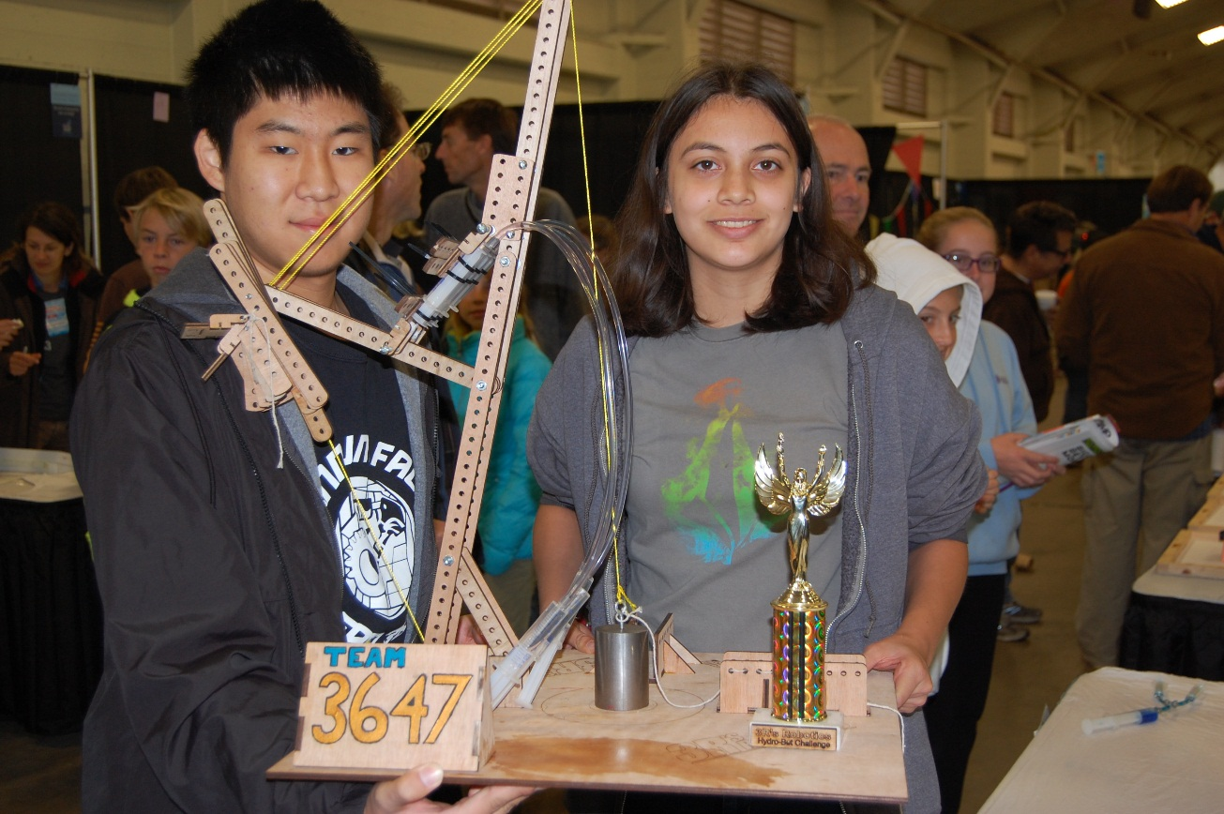
LEVERS
Six simple mechanical machines in the Hydro-Bot Challenge
Notes:
Intergalactic explorers, welcome aboard our cosmic journey into the world of levers! Today, we're diving deep into the realm of simple machines, where a little leverage goes a long way. But before we launch into the fascinating world of levers, let me set the stage with a dad joke to lighten the atmosphere:
Why did the lever go to therapy?
Because it felt unbalanced and needed some leverage to get back on track!

Slide 2
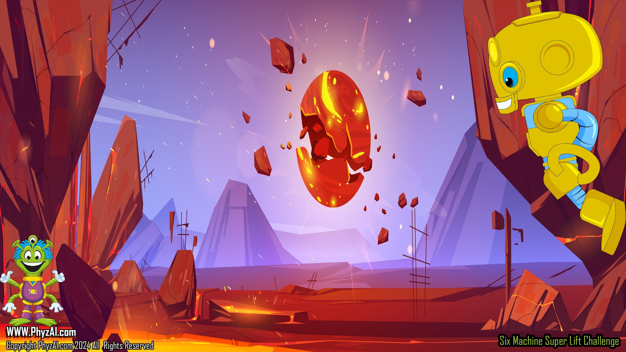

Six Simple Machines
Wh
E
E
L
Load
Effort
Effort
Effort
LEVER
Axel
FULCRUM
Load
Load
Load
Effort
Wedge
Effort
Effort
Load
Load
Load
Notes:
It was Archimedes who said, "Give me a lever long enough and a fulcrum on which to place it and I shall move the world.“ ,,,
In this lesson, we'll be learning about levers, the most important of the six simple machines in the design of the Super-Lift.

Slide 3

Lever
Load
Effort
LEVER
FULCRUM
A lever allows us to either amplify force by making a given effort lift more load or we can trade force for travel distance. There are three types of levers.
Notes:
If you've ever used the wheelbarrow, a lawn rake, a seesaw, or even a screwdriver, then, my friend, you've harnessed the power of the lever. This simple yet ingenious device is a bar that gracefully pivots around a steadfast point known as the fulcrum. And guess what?,,, There are three unique classes of levers we're about to explore. Ready for some lever-aging action?

Slide 4




1st Class Lever
Load
Effort
LEVER
FULCRUM
Notes:
With first class levers, the fulcrum, is always placed between the effort and the load. Of course,,, the load will always move in the opposite direction of the effort.

Slide 5


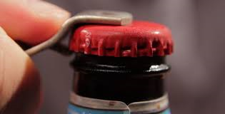
2nd Class Lever
Effort
Load
LEVER
FULCRUM
Notes:
With second class levers, the load is placed between the fulcrum and the effort. Now second class levers do not change the direction of the input force but they allow the load and the effort to move in the same direction. Of course,,, the output force is always greater than the input force with second class levers.

Slide 6


3rd Class Lever
Effort
Load
LEVER
FULCRUM
Notes:
With third class levers, you'll find the effort placed between the fulcrum and the load. The output force exerted by the lever is always going to be less than the effort put into it. Instead,,, third class levers actually help increase the distance over which the output force is applied.

Slide 7

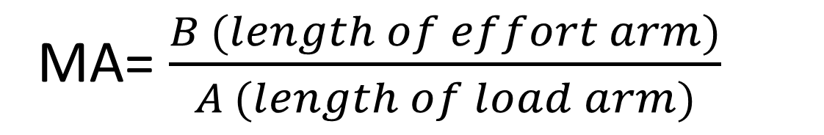
We can calculate the mechanical advantage we receive with a lever using the equation below.
Load
Effort
LEVER
FULCRUM
A
B
Notes:
In order to calculate the mechanical advantage of a lever, you must consider a few things. First, you must consider length of the load Arm “A” and the length of the effort Arm “B”.
So basically, you're looking at the length of the arms on either side of the fulcrum and dividing the length of the effort Arm “B” by the length of the load Arm “A”. The number you get represents the mechanical advantage provided by the lever that you are using.
,,,
Okay, so let's take a look at some of the results you might get when calculating mechanical advantage.
,,,
If you get a number that is equal to 1, it means that your effort force is exactly equal to your output force. If you get a number less than 1, it means that your effort force is much greater than your output force. And of course, if you get a mechanical advantage of greater than 1, it means that your effort force has been significantly increased on the output side.

Slide 8

Basic Lever
Effort
A lever allows us to lift a load that has more
weight than we have available force.
Load
Notes:
Here, you see an example of a lever where the effort force has been significantly increased on the load side.
This is because that force is being exerted over a very small distance.

Slide 9
A lever allows us to lift a load a greater distance
than we have available from our piston.
Effort
Load
Basic Lever
Notes:
In this example, we see a mechanical advantage of less than 1 where the output force is less than the effort force.
However, there is a significant gain in the distance that the load travels.

Slide 10

Basic Lever
Effort
Load
When working with levers,
we need to watch for the
horizontal motion in our
vertical lift. Levers move
things in arcs.
Horizontal
movement
Notes:
Now one of the rules to the Super-Lift Challenge is that you must lift the load without leaving the perimeter of the circle that is etched into the platform. Now, as levers lift loads, they do move in arcs. And that horizontal movement has to be accounted for in your design, because if you lift the load and it leaves the perimeter of that circle that is etched into the platform, it will result in an automatic disqualification.

Slide 11
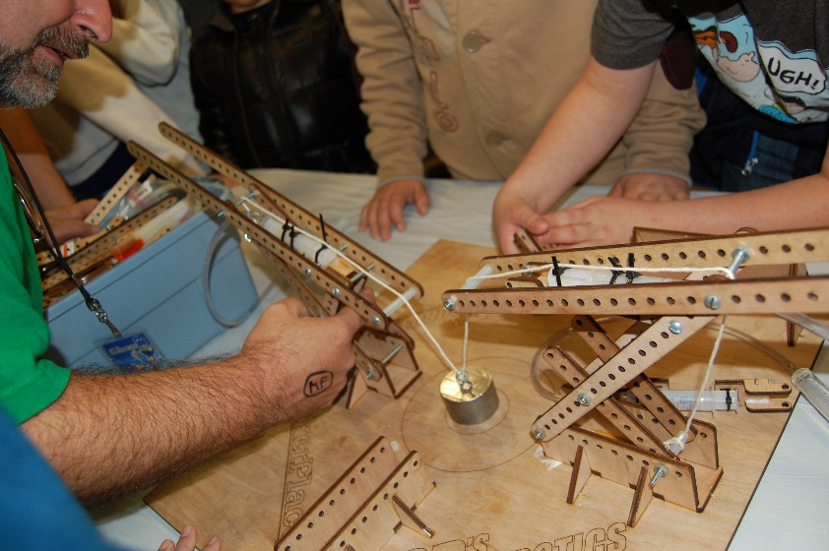
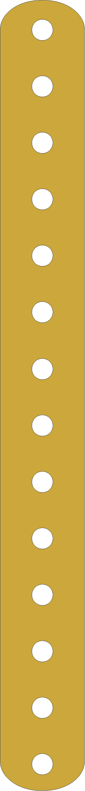
See-Saw Lifter
Notes:
Here is an example of a seesaw lifter or a first class lever that you might employ in the design of your Super-Lift. But remember, as this lever lifts the load, it does travel in an arc. So there is going to be some horizontal movement which you must take into account in your design.

Slide 12
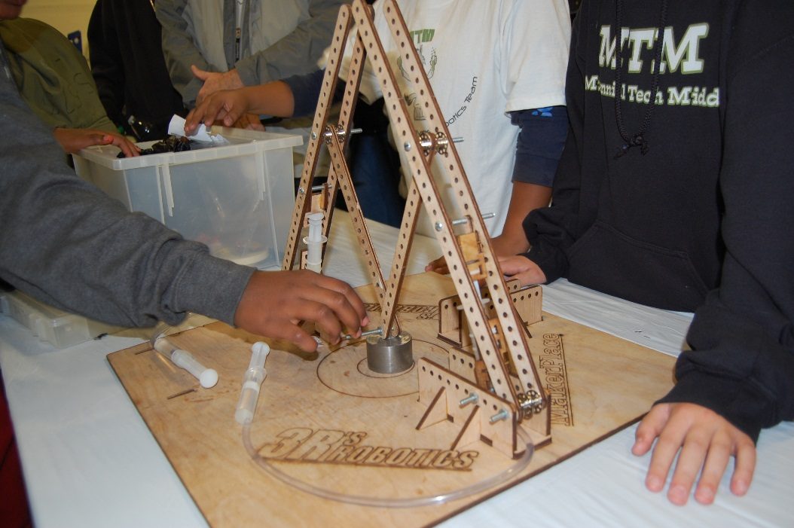
Twin A-Frame Lever
Notes:
This is a twin A frame lever. This lever is a prime example of the second class lever. It allows you to lift the load straight up from the platform with very little, horizontal travel.

Slide 13
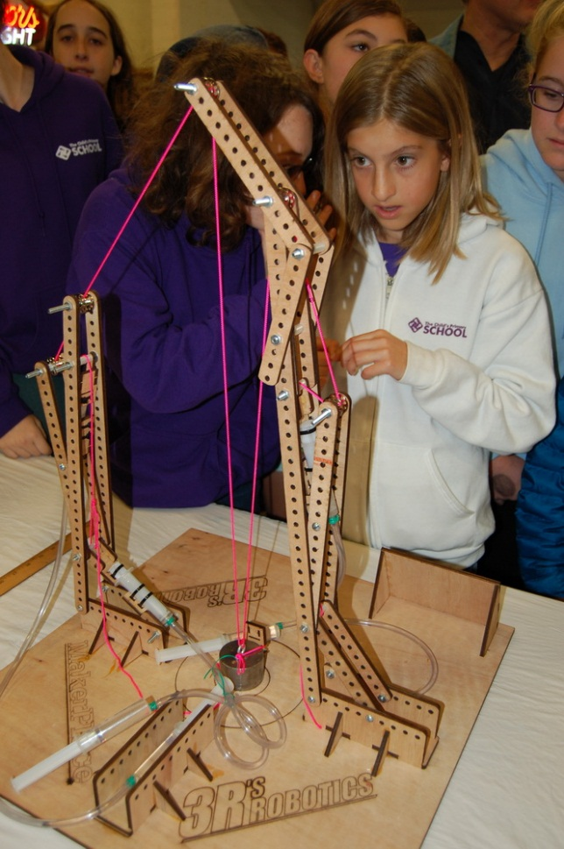
String Puller
Notes:
The string puller is a great example of a third class lever. While there is no mechanical advantage gained here, there is an increase in the distance through which the effort force is exerted.

Slide 14
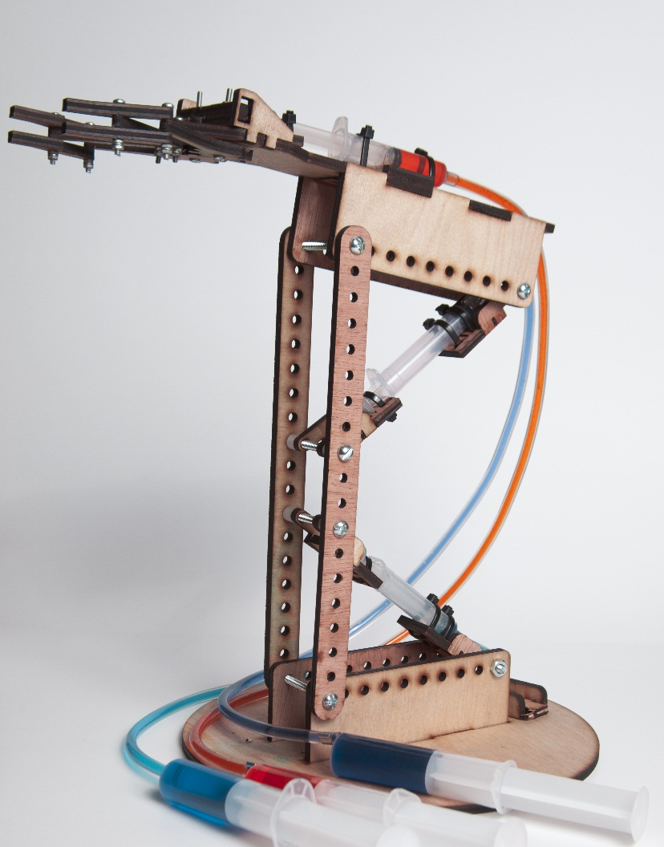
Complex machines will often have more than one lever working together to complete the assigned task.
Notes:
Often, the most effective Super-Lift designs employ more than one lever working together to lift the load off the platform. Use your knowledge of first, second, and third class levers to design the most effective Super-Lift that you can.

Slide 15
Let’s look at the winning design from 2013
Hydro-Bot Lift Challenge.
Notes:
Here's a look at the winning design from the 2013 Challenge. This particular design was able to lift the 1.25 pound load over 17 inches off the platform.
Pretty impressive!

Slide 16
Some Hydro-Bot Challenges allow the use of Counterweights.
Counterweights are a very effective way to increase effort on the lever while requiring less effort from machinery providing that force. However, these systems greatly add to the forces applied to the physical structure holding the lever and can make them very unstable.
50% Effort
Load
50% Effort
Counterweights
Notes:
There are many different strategies that you can employ when designing and building your Super-Lift. Remember to weigh out the pros and cons of each strategy before integrating it into a design.

Slide 17

Looking at these entries from other schools, can you tell how they used levers to give them mechanical advantage in their lift attempts?
Notes:
Take a glance at these Lifts that were used in earlier Challenges. Each of these schools employed various types of levers to give them mechanical advantage in their lifts. Can you identify at least one example of each of the three classes of lever?

Slide 18
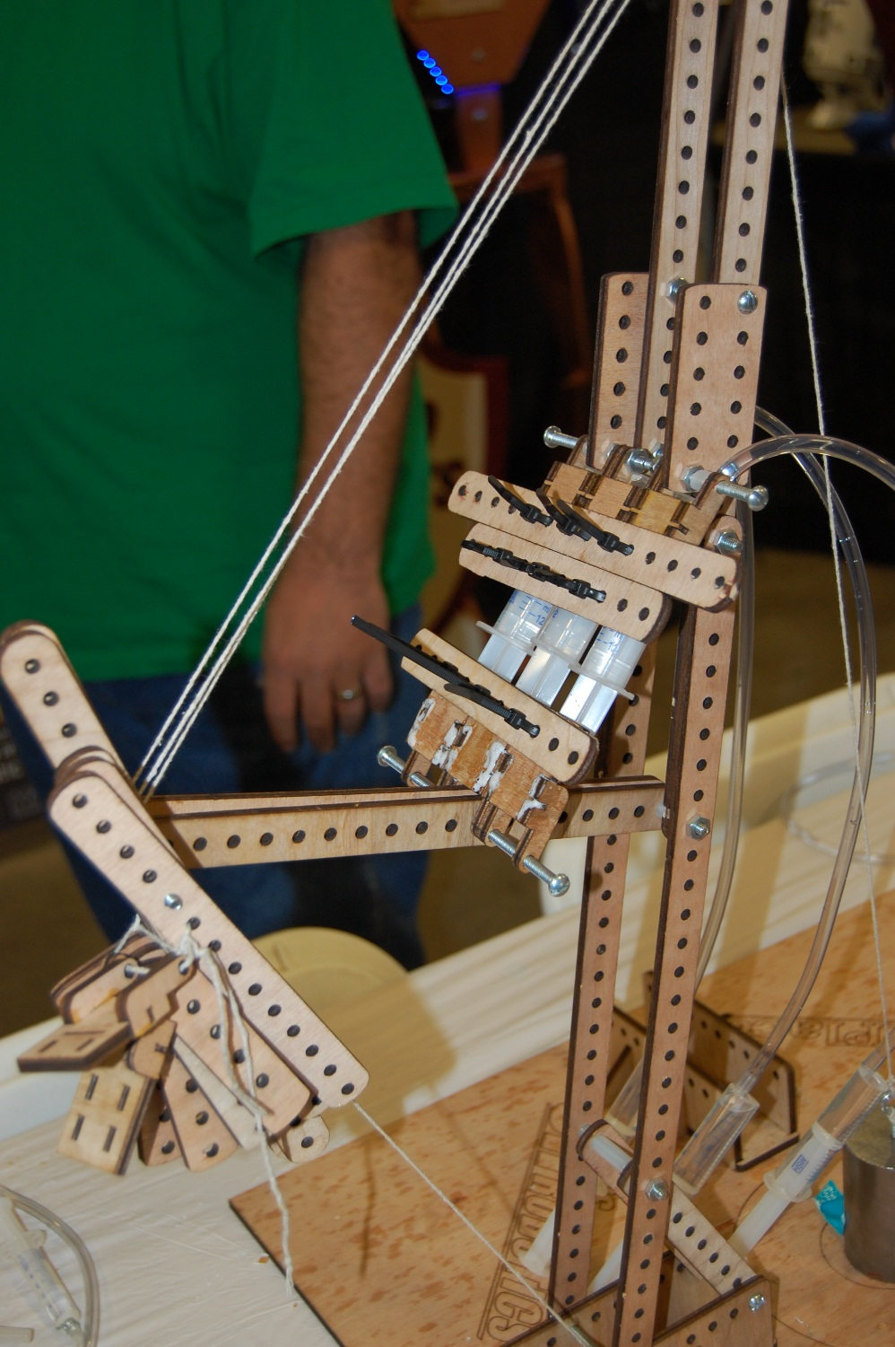

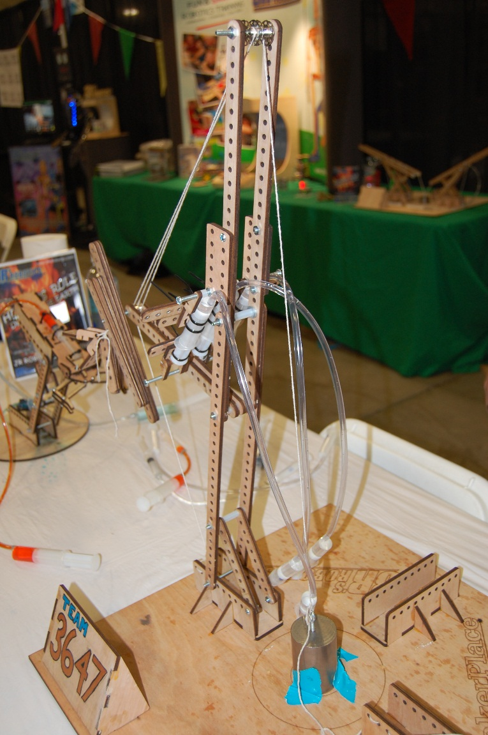

Slide 19


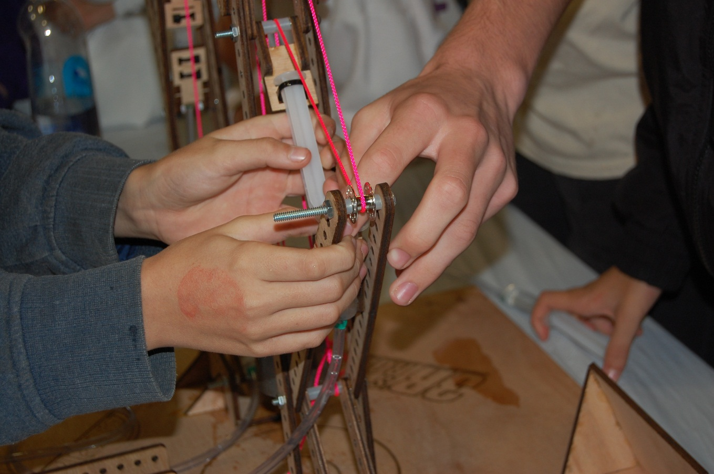
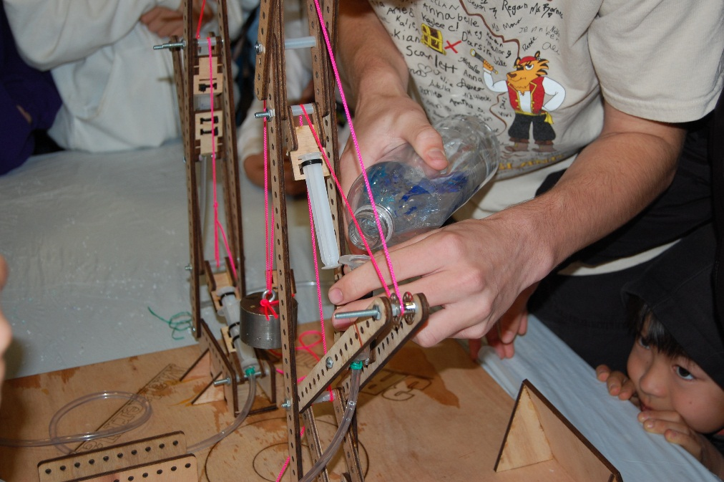


Slide 20
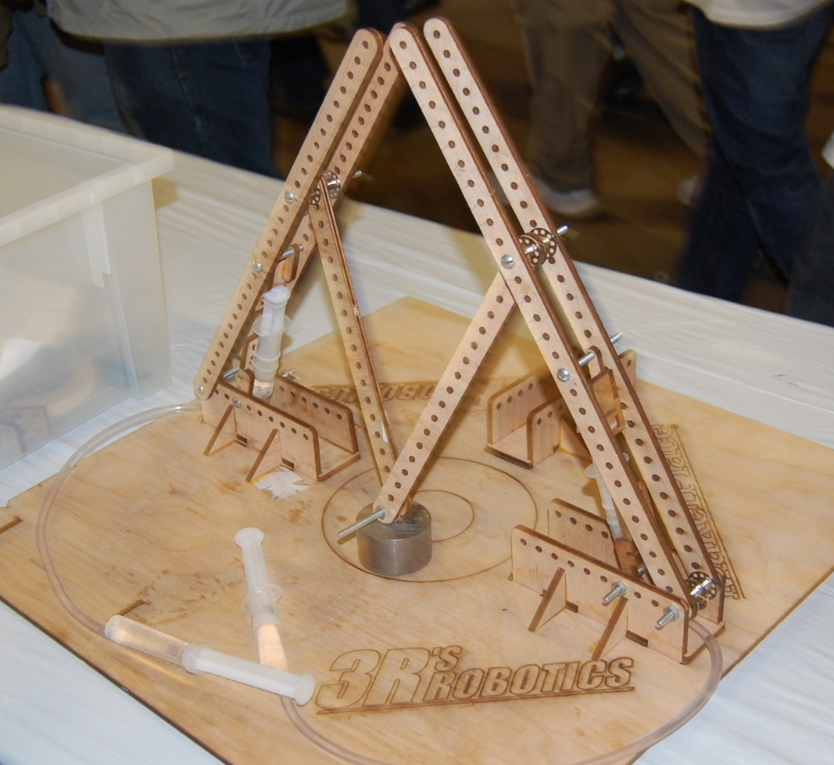
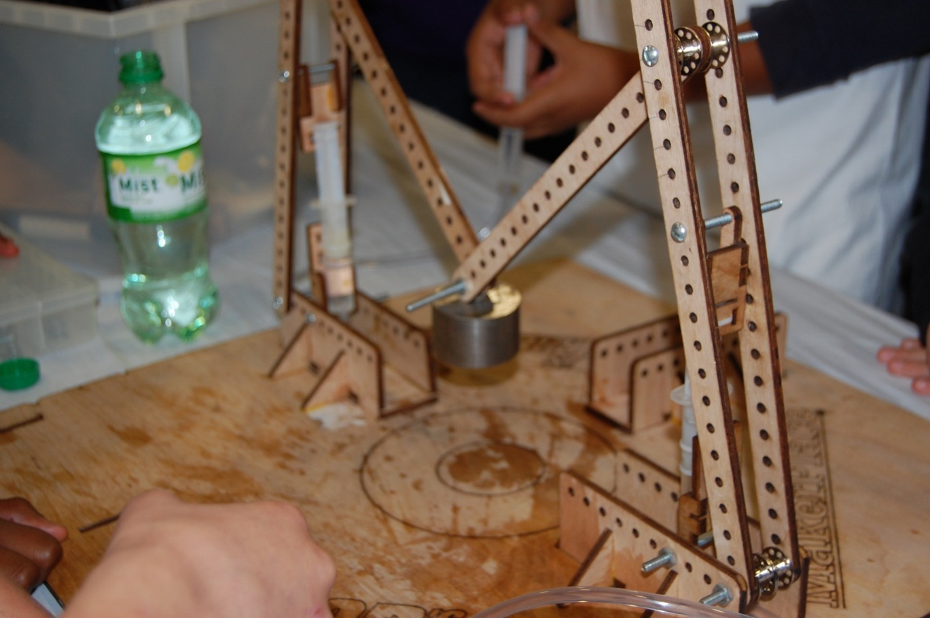
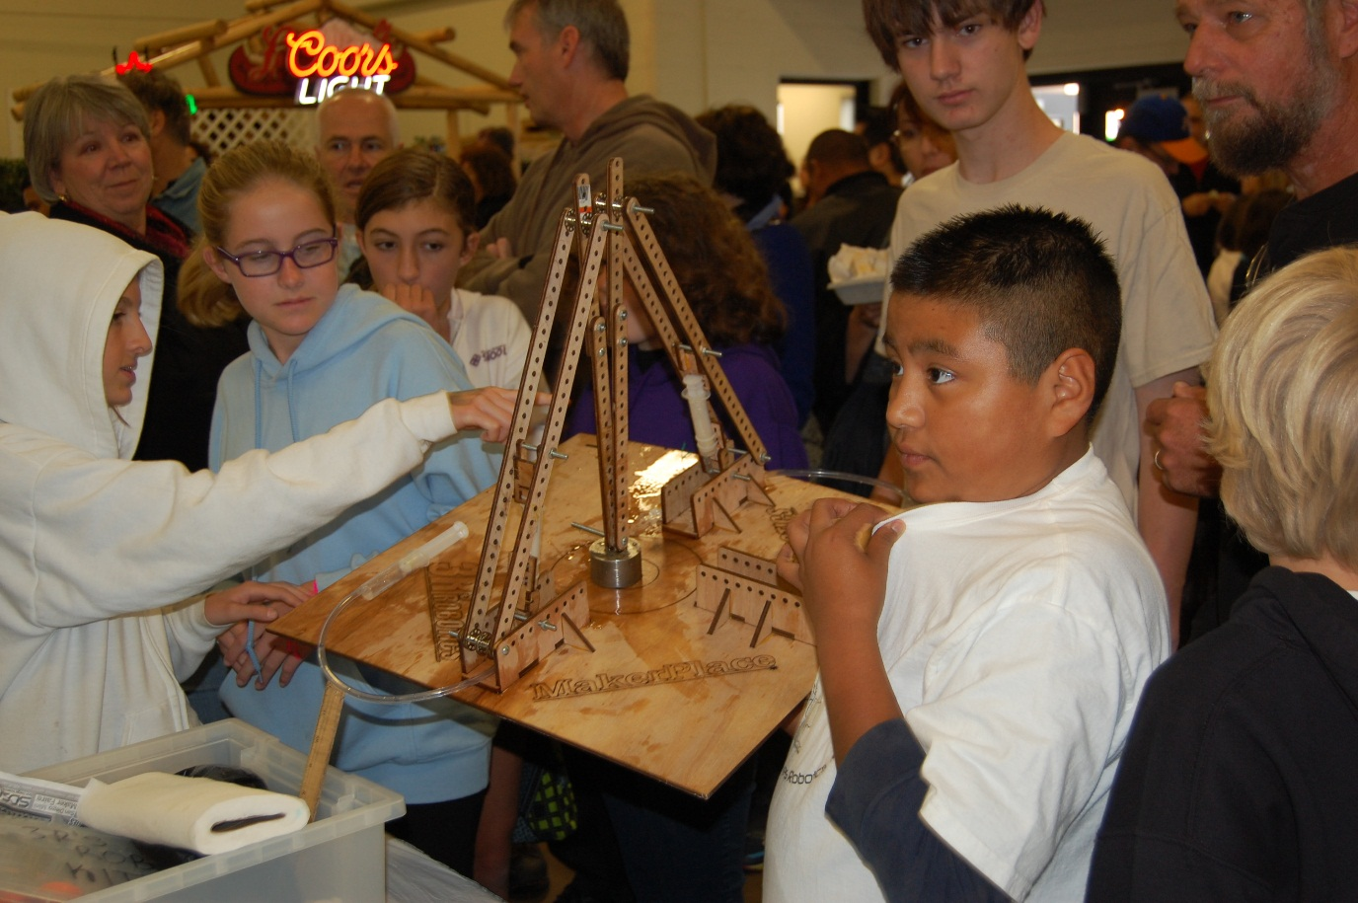

Slide 21
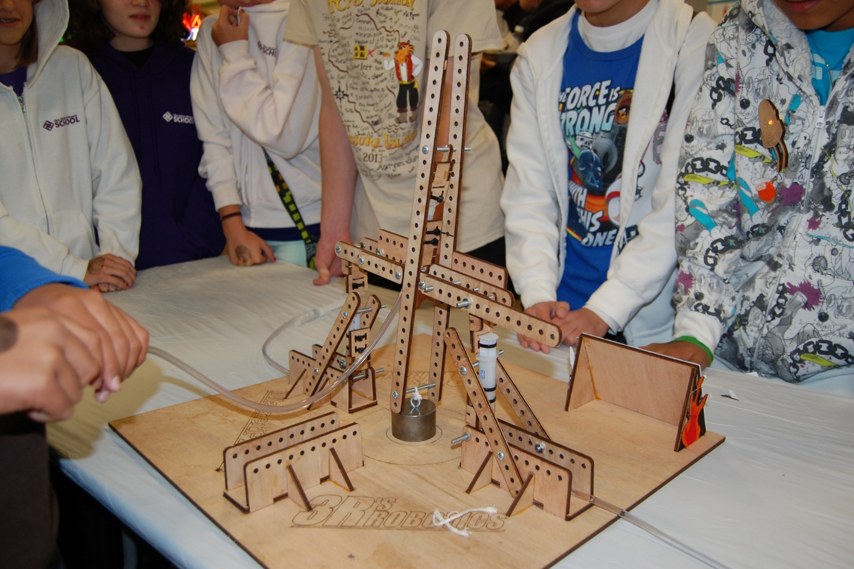
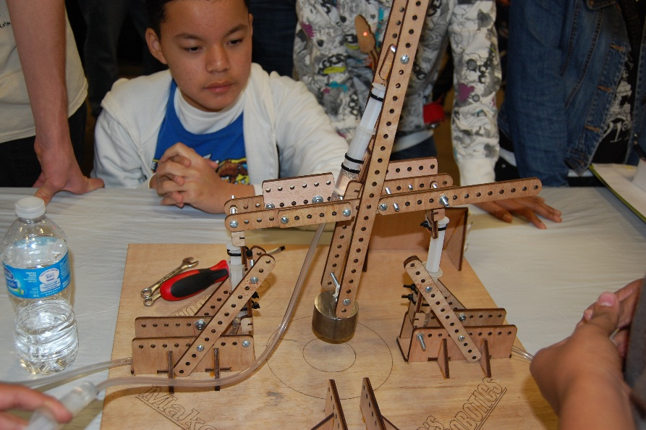
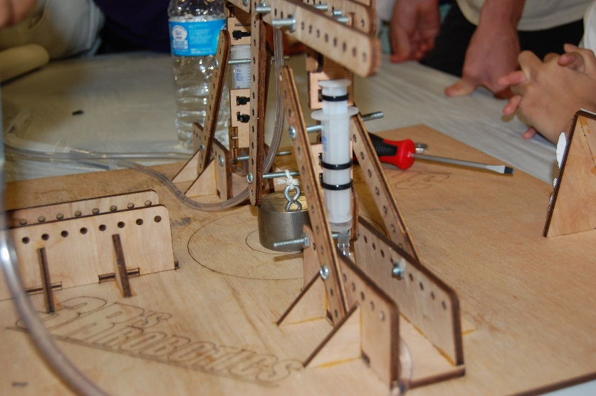
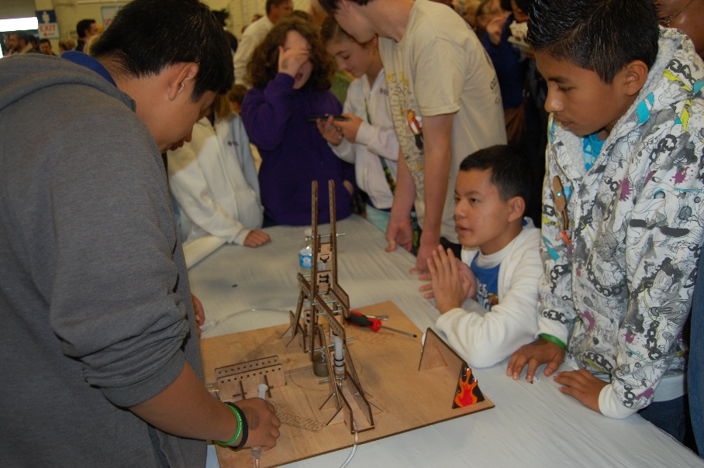

Slide 22

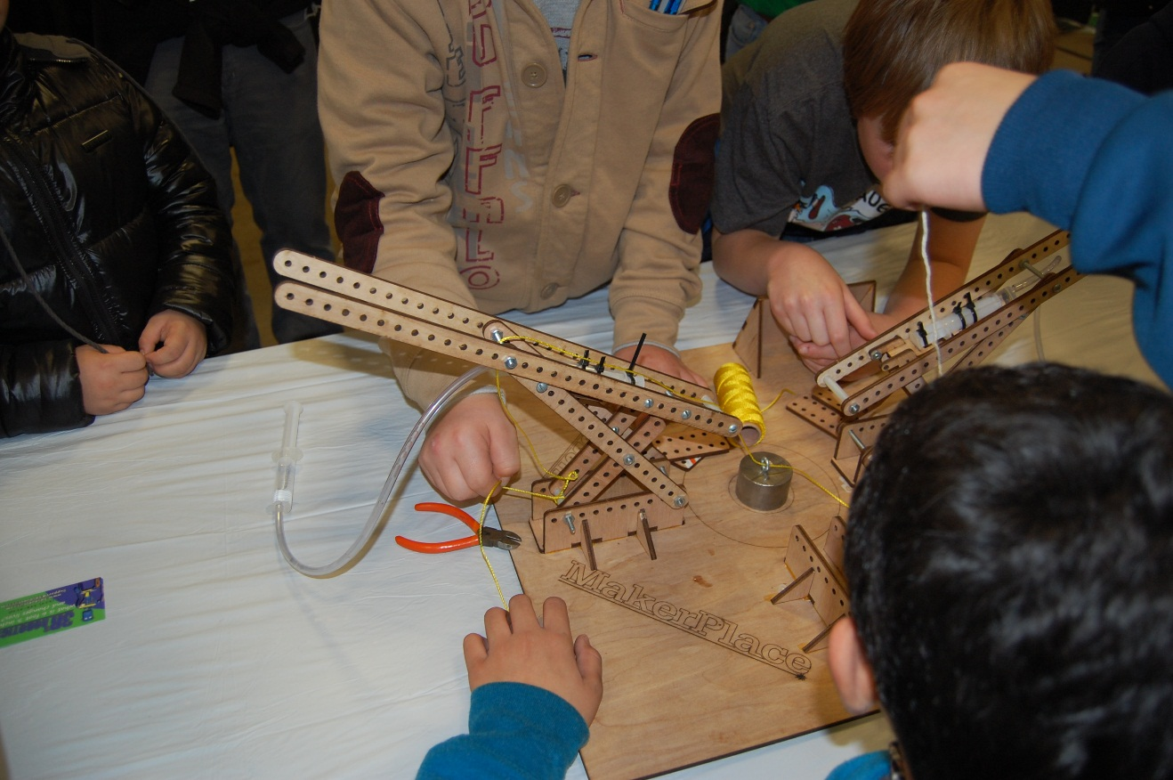
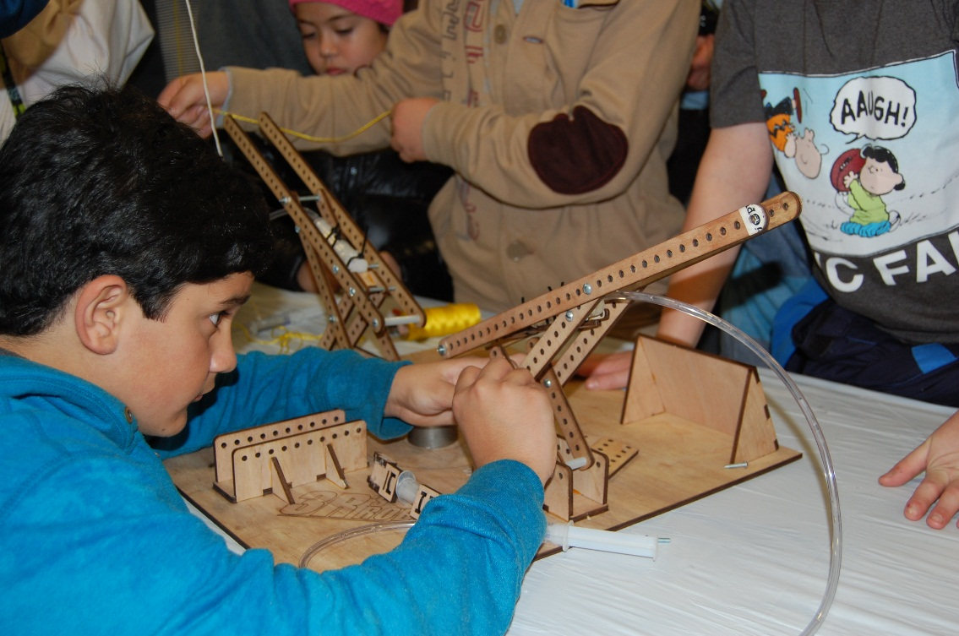

Slide 23

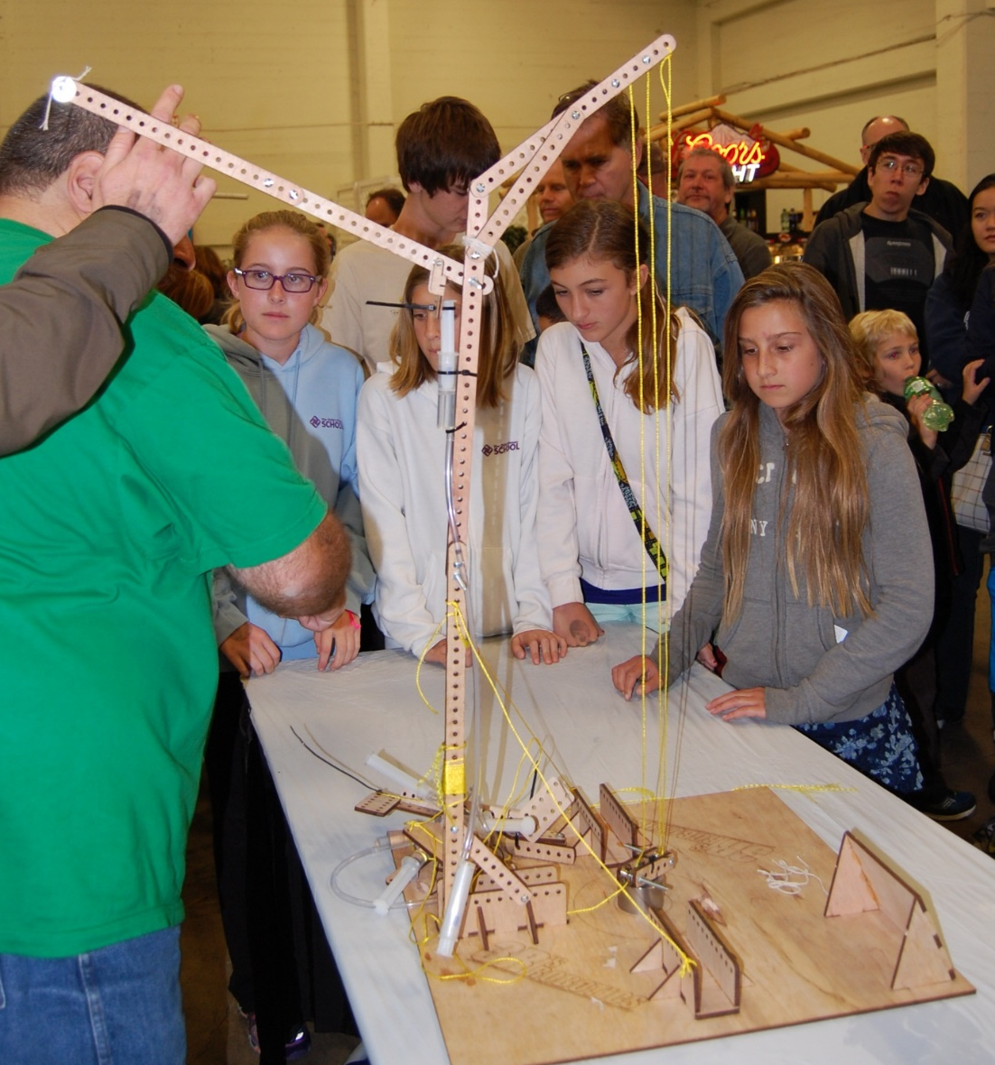
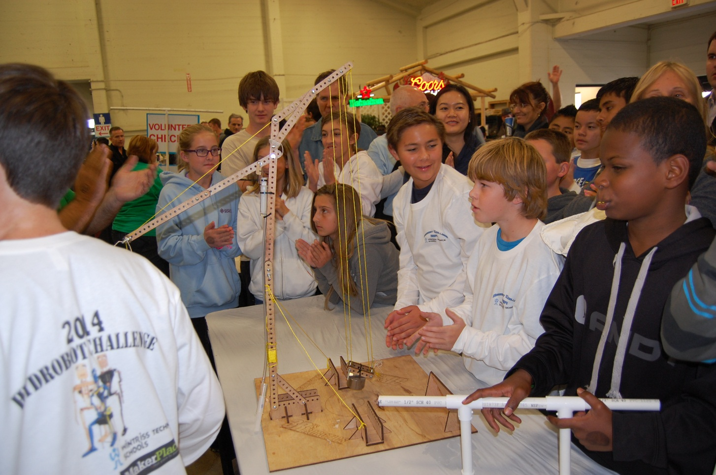
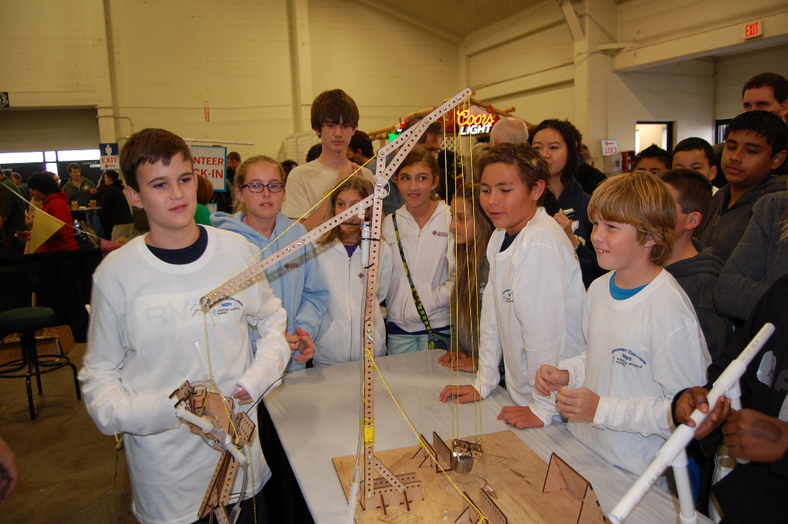

Slide 24
Success in any of the Hydro-Bot Challenges requires the creative use of levers. They are the best tool we have for maximizing force and adding pulling distance for your string.
Notes:
Just as the ancient Egyptians harnessed the power of levers to erect the majestic pyramids of Giza over **4000 years ago**, you too can channel your understanding of this timeless tool to engineer the most spectacular Super-Lift the universe has ever seen. Wishing you stellar success!

